Slide 1

Operating Systems: A Modern Perspective, Chapter 10

Slide 2
Pipes
Pipes are a way to allow processes to communicate with each other
  Pipes implement one form of IPC (Interprocess Communication)
  This allows synchronization of process execution
There are two kinds of pipes
  named pipes
  unnamed pipes
Pipes are uni-directional
  They can only transfer data in one direction
  If you want two processes to have a two-way conversation, you must use two pipes

Slide 3





Pipes Implement a FIFO
A FIFO (First In, First Out) buffer is like a queue or a line at a movie theater
Elements are added at one end of the queue and exit the other end in the same order
There is no way for any individual element to move ahead of another

Slide 4
Traditional implementation of pipes uses the file system for storage
  This allows processes to communicate even though they don’t know what processes are at the other end of the pipe
Unnamed pipes can only be used between processes that are children of the process that initiated the pipe
Named pipes solve this problem - any process can communicate with another using named pipes

Slide 5
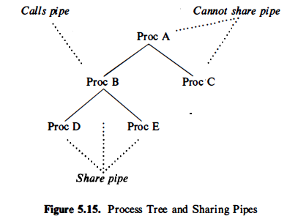
Process tree and sharing pipes
Operating Systems: A Modern Perspective, Chapter 10

Slide 6
Unnamed Pipes
Unnamed pipes are used as we saw in Unix cat myfile | grep key | sort | lpr
The parent process (the shell or shell script that creates the pipes) also spawns the child processes that access the pipe
  cat, grep, sort, and lpr in this case
  Note: the shell or script process that sets up the pipes CANNOT access the pipes itself!

Slide 7
Named Pipes
Named pipes can be accessed by any process that “knows the name”
Named pipes appear in the user’s directory list
  $ls -l
  pwr_r__r__ 1 krf 0 Mar 27 19:33 mypipe

Slide 8
Named Pipe Creation
Named pipes are created using the mknod or the mkfifo commands
  mkfifo name
  or mkfifo –m mode name
  mknod name p
Make sure you remove (rm) your pipes after use!

Slide 9
Using Named Pipes
First, create your pipes
  mknod pipe1 p
  mknod pipe2 p
  mknod pipe3 p
Then, attach a data source to your pipes
  ls -l >> pipe1 &
  cat myfile >> pipe2 &
  who >> pipe3 &
Then, read from the pipes with your reader process
  cat < pipe1 | lpr
  spell < pipe2
  sort < pipe3
Finally, delete your pipes
  rm pipe[1-3]
Notes:
Note: >> to append to pipe
& for background execution

Slide 10
UNIX Pipes
The pipe interface is intended to look like a file interface
  Analog of open is to create the pipe
  File read/write system calls are used to send/receive information on the pipe
What is going on here?
  Kernel creates a buffer when pipe is created
  Processes can read/write into/out of their address spaces from/to the buffer
  Processes just need a handle to the buffer
Operating Systems: A Modern Perspective, Chapter 9

Slide 11
UNIX Pipes
Address Space for p₁
Info to be
shared
Info copy
write(pipe[1], …);
read(pipe[0]);
System Call Interface
pipe for p₁ and p₂
write function
read function
Operating Systems: A Modern Perspective, Chapter 9

Slide 12
UNIX Pipes (cont)
File handles are copied on fork
… so are pipe handles
int pipeID[2];
. . .
pipe(pipeID);
. . .
if(fork() == 0) { /* the child */
. . .
read(pipeID[0], childBuf, len);
<process the message>;
. . .
} else { /* the parent */
. . .
write(pipeID[1], msgToChild, len);
. . .
}
Operating Systems: A Modern Perspective, Chapter 9

Slide 13
Code fragment: Named Pipes
Char string[]=“Hello”;
main(argc, argv)
int argc;
char* argv[];
int fd;
char buf[256];
mknod(fifo”,010777,0) /* Create Pipe RW=all*/
if (argc==2)
fd = open(“fifo”, 0_WRONLY;
else
fd = open(“fifo”, 0_RDONLY);
for (;;)
if (argc==2)
write (fd, string, 6);
else
rd (fd, buf, 6);

Slide 14
SOCKETS
Operating Systems: A Modern Perspective, Chapter 10

Slide 15
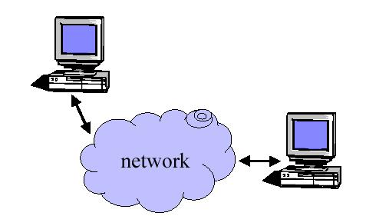
Why do we need sockets?
Provides an abstraction for interprocess communication

Slide 16
What are sockets?
Socket is an abstraction for an end point of communication that can be manipulated with a file descriptor.
It is an abstract object from which messages are sent and received.
Sockets are created within a communication domain just as files are created within a file system.
A communication domain is an abstraction introduced to bundle common properties of processes communicating through sockets. Example: UNIX domain, internet domain.

Slide 17
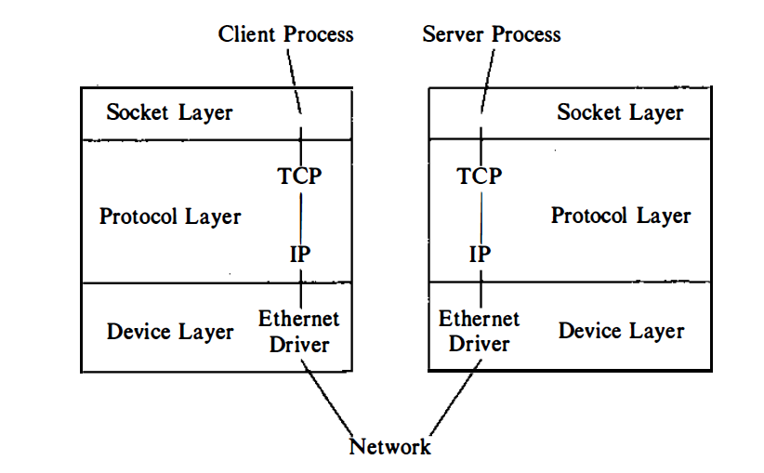
Socket model
Operating Systems: A Modern Perspective, Chapter 10

Slide 18
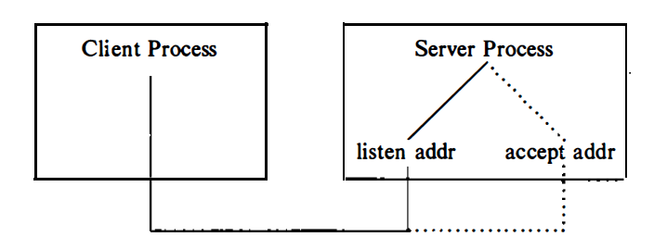
A server accepting a call
Operating Systems: A Modern Perspective, Chapter 10

Slide 19
Functions
  Define an “end- point” for communication
  Initiate and accept a connection
  Send and receive data
  Terminate a connection gracefully
Examples
  File transfer apps (FTP), Web browsers
  (HTTP), Email (SMTP/ POP3), etc…

Slide 20
Sockets
  a socket is an IPC mechanism for transmitting data from one process to another both within a single machine and between machines
  a socket is a bi-directional IPC channel
  Domains for sockets - a domain is the space from which an address is drawn for a socket
    UNIX domain(AF_UNIX)
      uses the UNIX file system name space
      used for local IPC
    Internet domain(AF_INET)
      uses Internet address plus a port number
      used for local and remote IPC

Slide 21
3 Types of Socket
Stream sockets interface to the TCP (transport connect protocol).
Datagram sockets interface to the UDP (user datagram protocol).
Raw sockets interface to the IP (Internet protocol).

Slide 22
Addresses, Ports and Sockets
Like apartments and mailboxes
  You are the application
  Your apartment building address is the address
  Your mailbox is the port
  The post-office is the network
  The socket is the key that gives you access to the right mailbox

Slide 23
Sockets and ports
any port
agreed port
socket
socket
message
client
server
other ports
Internet address = 138.37.94.248
Internet address = 138.37.88.249
B.R

Slide 24
Sockets used for streams
Requesting a connection
Listening and accepting a connection
s = socket(AF_INET, SOCK_STREAM,0)
s = socket(AF_INET, SOCK_STREAM,0)
bind(s, ServerAddress);
connect(s, ServerAddress)
listen(s,5);
sNew = accept(s, ClientAddress);
write(s, "message", length)
n = read(sNew, buffer, amount)
ServerAddress and ClientAddress are socket addresses

Slide 25
socket()
TCP Server
bind()
Well-known port
TCP Client
listen()
Socket()
accept()
connect()
Connection establishment
blocks until connection from client
write()
Data(request)
read()
process request
Data(reply)
write()
read()
close()
End-of-file notification
read()
close()

Slide 26
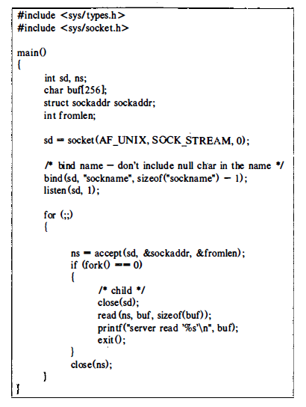

Server process in unix system
Operating Systems: A Modern Perspective, Chapter 10

Slide 27
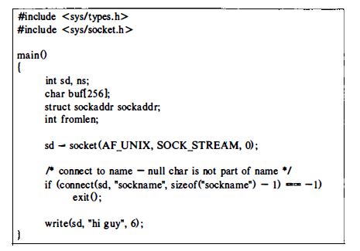
A client process
Operating Systems: A Modern Perspective, Chapter 10

Slide 28
Definition : Signals
A signal is an asynchronous event which is delivered to a process.
Asynchronous means that the event can occur at any time
  may be unrelated to the execution of the process
  e.g. user types ctrl-C, when the system hangs
3/24/2011

Slide 29
Linux Signals
A LINUX signal corresponds to an event
  It is raised by one process (or OS) to call another process’s attention to an event
  It can be caught (or ignored) by the subject process
3/24/2011

Slide 30
More on Signals
UNIX has a fixed set of signals (Linux has 32 of them)
signal.h defines the signals in the OS
Each LINUX signal has an integer number and a symbolic name Defined in <signal.h>
3/24/2011

Slide 31
Signals
Most signals have predefined meanings:
sighup (HangUp): when a terminal is closed, the
hangup signal is sent to every process in control terminal.
sigint (interrupt): ask politely a process to terminate.
sigquit (quit): ask a process to terminate and produce a
codedump.
sigkill (kill): force a process to terminate.
3/24/2011

Slide 32
Signal Sources
terminal
driver
memory
management
shell command
SIGINT
SIGHUP
SIGQUIT
SIGKILL
kernel
SIGPIPE
SIGWINCH
SIGALRM
window
manager
a process
SIGUSR1
other user
processes
3/24/2011

Slide 33
Sending signals to process. (by keyboard)
Ctrl-c
This causes the system to send an INT signal
(SIGINT) to the running process which causes
The process to immediately terminates.
Ctrl-z
This causes the system to send an TSTP signal(SIGTSTP) to the running process this causes The process to Suspend execution.
Ctrl-\
This is same as ctrl-c but with better flexibility
This sends ABRT Signal (SIGABRT)
3/24/2011

Slide 34
Signal transmission
The mechanics consist of two distinct steps:
Signal Generation: The kernel updates data structure of the destination process to represent that a new signal has been sent
Signal delivery: The kernel forces the destination process to react to the signal by changing its execution state, by starting the execution of a specified signal handler.

